Slide 1


I’M FINE
B I U & I B M
2019 Hackathon in the topic of Natural Disasters
Ariel Vetzler
Ofir Henig
Ori Fogler

Slide 2
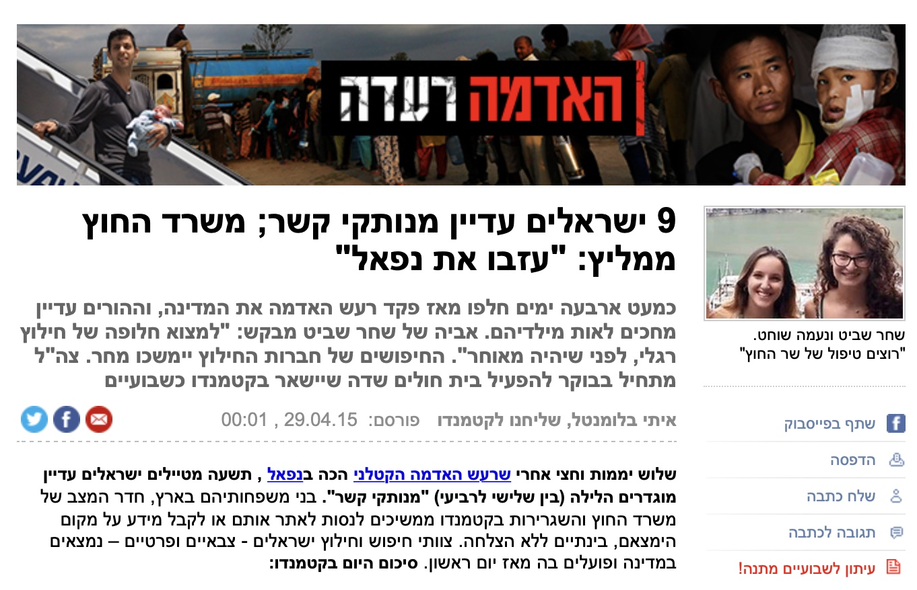
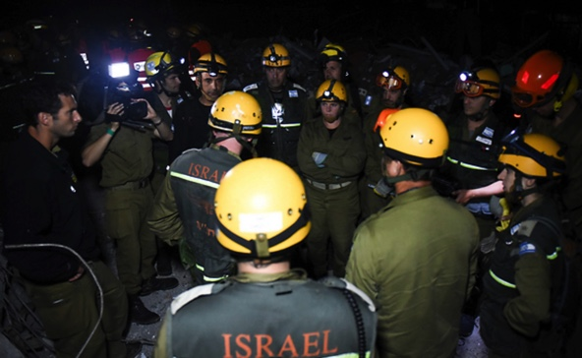
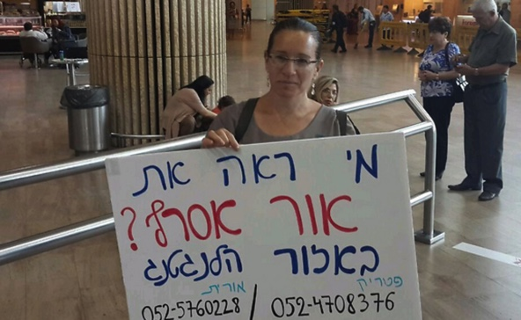
Typical Scenario

Slide 3
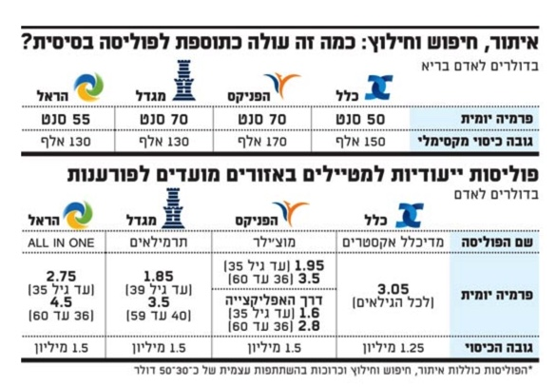
Disconnection Consequences
Worried families
~30 Israelis each year
1135 in the US last year
Search costs
Insurance companies
Foreign ministry
The families
150,000$ - 1,500,000$

Slide 4
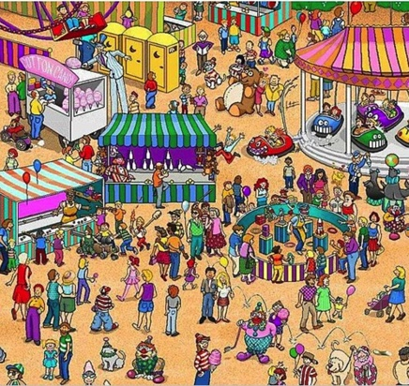

Use Case
Efi is missing
Spontaneous videos are published
Relevant videos are targeted
People images are recognised
Searchers send Efi’s image
Images compared

Slide 5
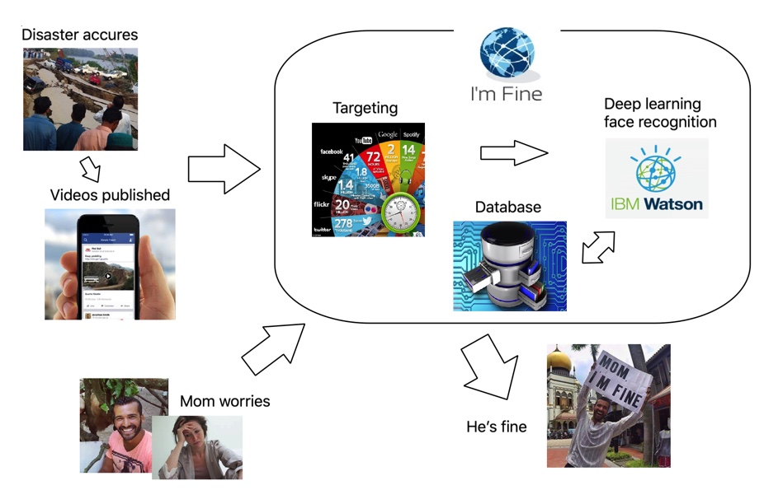
Flow & Architecture

Slide 6
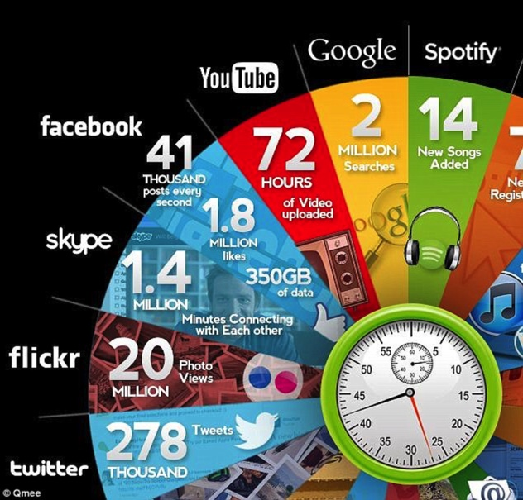
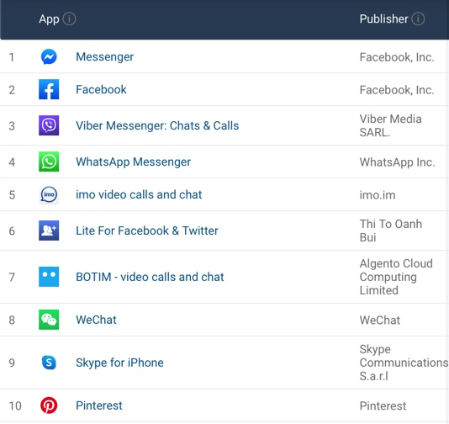
Targeting Videos
Popular social networks
For each country
Filter the searches
By time & location
By keywords

Slide 7

Spontaneous Videos
Dozens or hundreds of videos like:

Slide 8
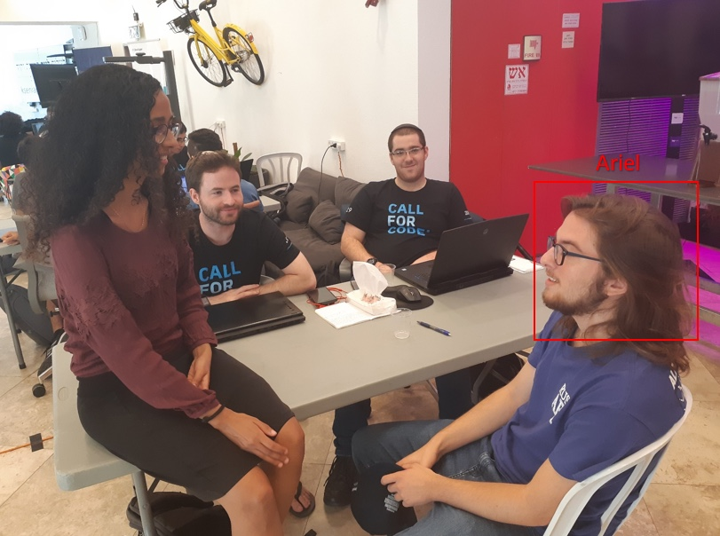
Deep Learning Face Recognition

Slide 9
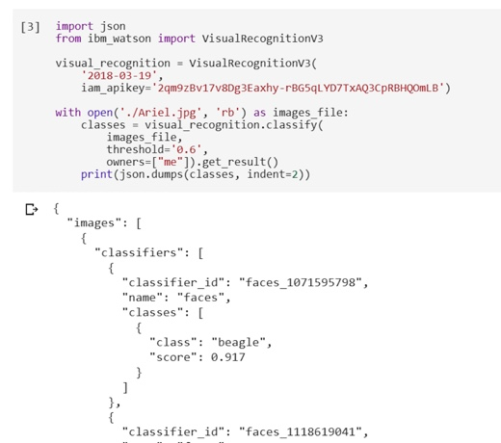
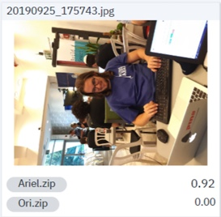
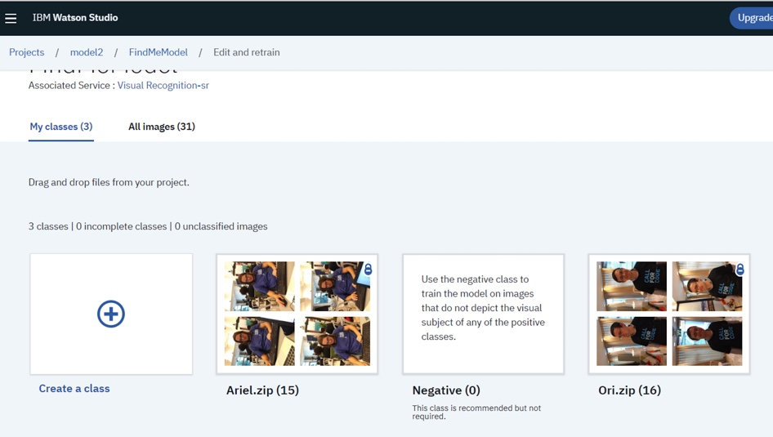
Watson Visual Recognition

Slide 10
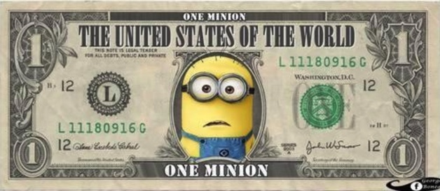
Market & Business
Both B2B & B2C
Insurance companies
Reduce costs and risk
Governments
Reduce costs
Relax citizens

Slide 11

Future Plans
Web & Mobile UIs
Legal advisement
Scale the system
By IBM tools & services
Technological cooperation
With social networks
With search engines

Slide 12
Thanks all the involved from IBM and BIU for this great event!

